Slide 1
Predicting user contacts
John Houkal
9/3/2018

Slide 2
The Problem
As our user base changes (often unpredictably), so do our staffing needs. A robust model for predicting contacts enables us to make better staffing decisions
Current modeling is adequate, but imprecise. It is reactive and often inflexible
In part, this is due to messy and disconnected data

Slide 3
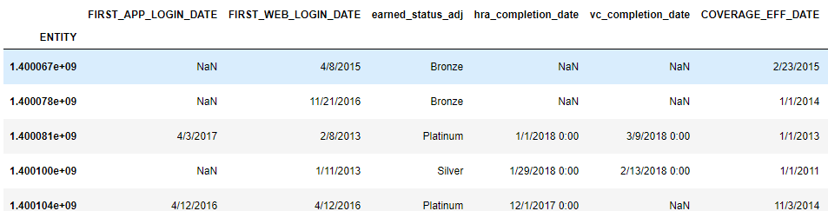
Metrics & Assumptions
Three SQL server tables employed: login, third-party device, and key event records
Contact data from 1/1/18 pulled from Salesforce and merged on common UUID
Around 536k rows with fifteen feature columns (some useless)
I assume “more engaged” users are likelier to contact us

Slide 4
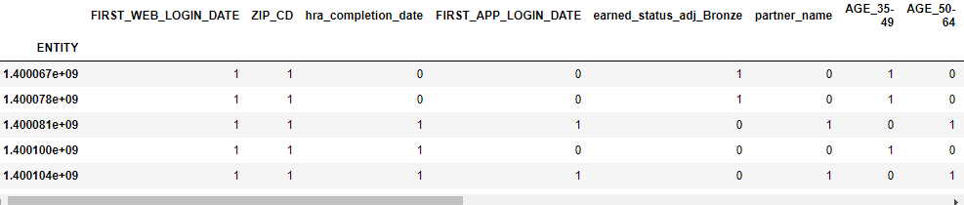
Approach & Process
Collected and standardized heterogeneous data into simple binary T/F arrangements
This enables us to track and train engagement factors against call center contacts

Slide 5
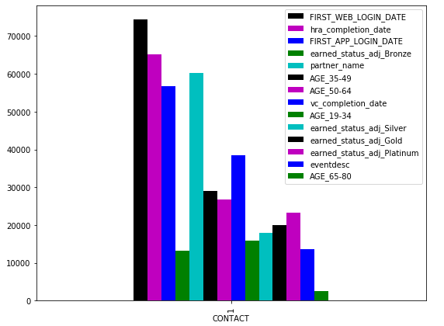
Approach & Process (cont.)
It likewise permits standard scoring based on relative engagement using key product engagement touchpoints

Slide 6
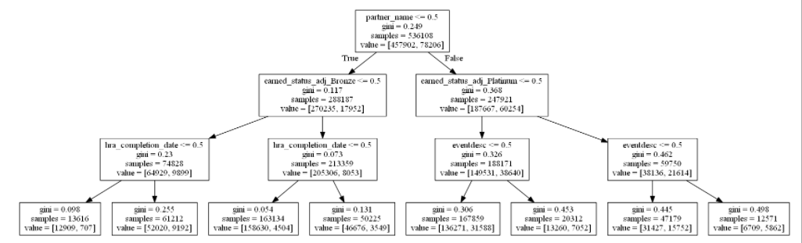
Solution
As expected, highly engaged members are likelier to contact us. More surprising is the ranking and weight of certain features
Thus, we can assign an importance factor to each feature column—thereby allowing us to predict contact conversions with greater confidence than before

Slide 7
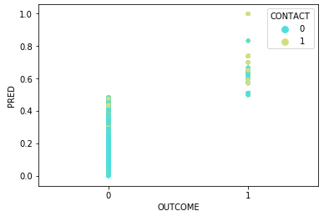
Performance Evaluation
Per RMSE tests, this model performed better than simply assuming that the most engaged half of this cohort would contact us
<10 minutes from query to intelligible output
Performed significantly better than linear and logistic regression models using unmutated data
Notes:
RMSE from 0.6 to 0.3

Slide 8
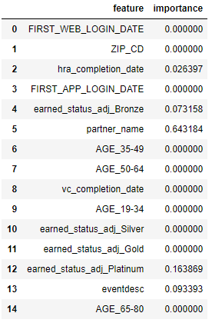
Impact of Findings
Assigning a sort of contact factor to features, such as device linkage, enhances our understanding of how product offerings, given other demographic factors, may affect support bandwidth
It also helps us make smarter staffing decisions especially as our support needs change—often unpredictably

Slide 9
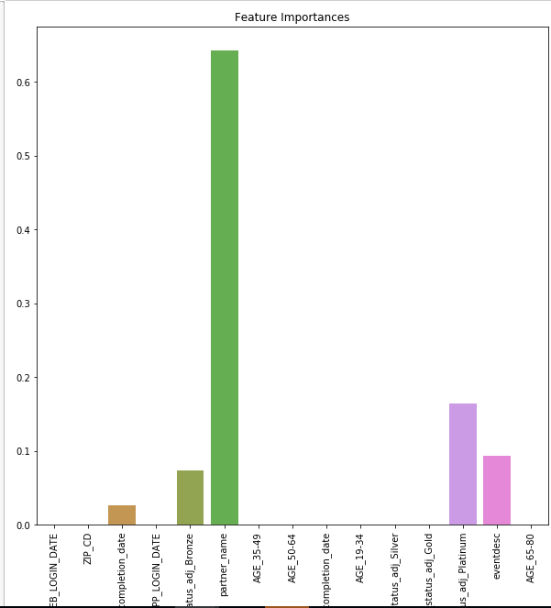
Impact of Findings (cont.)
Aids in user base segmentation. Low-engagement members are likely to contact us for different reasons than high-engagement ones
This knowledge should facilitate how we think about feature enhancements and member outreach tactics

Slide 10
Recommended Next Steps
Expand data; pull in more contact features where possible, including demographic features
Study reasons for contact using this same data to understand how best to segment it
Quantify value of employing a model like this over what we currently use. This will require historical data
Impact of third-party device linkage should probably be unpacked further. One specific device may impact rate of contact significantly more than the others
Include client industry data for better demographic understanding

